Slide 1

KIET Group of Institutions
DEPARTMENT OF COMPUTER APPICATIONS
PRESENTATION ON
Blue Brain
SUBMITTED BY:
ROLL NO. :- 1900290149042
NAME :- Dharmendra Tomar
SEMESTER :- VI
SECTION :- A
DATE:- 24 April 2021

Slide 2
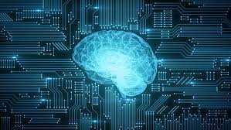
Introduction
Blue Brain:-
Blue brain is the name of the first virtual brain in the world.
After death, the human body gets destroyed, brain stops working and human eventually loses his/her knowledge of the brain. But this knowledge and information can be preserved and used for thousands of years.

Slide 3
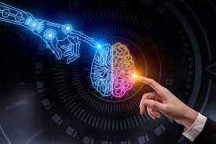
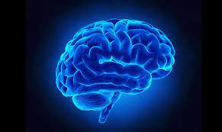
The Blue Brain Project is a Swiss brain research initiative that aims to create a digital reconstruction of the mouse brain. The project was founded in May 2005 by the Brain and Mind Institute of École Polytechnique Fédérale de Lausanne (EPFL) in Switzerland.

Slide 4
Working Module of Blue Brain :-
Associated with each core is a 64-bit “double” floating point unit (FPU). ... The Blue Brain Projects Blue Gene is a 4-rack system that has 4,096 nodes, equal to 8,192 CPUs, with a peak performance of 22.4 TFLOPS. A 64-rack machine should provide 180 TFLOPS, or 360 TFLOPS at peak performance.

Slide 5
NEED OF BLUE BRAIN :-
Intelligence is the quality through which all of us are different from each other. It is the inborn quality.
There are some people having a very high level of intelligence. Sometimes they think up to such extent that other’s cannot reach.
Examples are Newton etc.
But after the death the intelligence is lost. The solution to this is the Virtual Brain. Through this it can be preserved even after death.
We all suffer from a problem of remembering history and important days etc. This all can be done by virtual brain.

Slide 6
FUNCTIONING OF BLUE BRAIN :-
Firstly, it becomes quite important to understand how the person’s brain can be uploaded into a computer. Raymond Kurzweil published a paper on this topic and provided that the use of small robots or nabobs is excellent.
They are small enough to travel through our circulatory system. They would be able to monitor the activities of the nervous system. They will provide the interface with computer. By scanning our brain it will provide the clear information of the connections of neurons.
They would record the current state of brain. All these information when entered into computer, it will work as us. All what is required is the super computer with large space and processing power

Slide 7
STEPS OF BUILDING A BLUE BRAIN There are basically three steps of building a blue brain :- 1.Collection of Data 2. Simulation of Data 3. Visualization COLLECTION OF DATA: It involves in the collection of brain portion and analyzing them under a microscope and understanding the electrical behavior individually of the neurons. The observations are transformed into algorithm which are further ready for simulation. SIMULATION OF DATA: There are 2 aspects of simulation 1. Speed of simulation 2. Simulation Workflow Speed of Simulation

Slide 8
MERITS:-
1. It can help deaf people to hear with the help of direct nerve stimulation.
2. The activity and thinking of different animals can be understood by interpretation of electric impulse from their brain.
3. Even after the death of a person his/her intelligence can be used for development of the society.

Slide 9
DEMERITS :-
1. Human will become dependent on machines.
2. Super computers use a large amount of power as much as 1MW.
3. If the neural schema of a particular person is hacked which is uploaded on blue brain can be misused.
4. Since we are providing a brain to machine, so thoughtfully it increases the risk of machine taking over the person.

Slide 10
APPLICATIONS AREAS :-
1. Data of 100 years can be tested.
2. Neural Code can be cracked.
3. Information Processing of Neocortical can be understood.
4. Whole brain simulation can be studied.
5. A drug for the Brain Disorders

Slide 11
CONCLUSION :-
Human brain is complex than any circuitry in the world. And we are able to scan ourselves in the computer in near future. The only serious threats raised are also overcome as we note the combination of biological and digital technologies. Despite all the problems and complexity faced in the implementation of this project, it is predicted that the project will be capable by the year 2023. As said by Henry Markham , “As with Deep Blue, Blue Brain will allow us to challenge the foundations of our understanding of intelligence and generate new theories of consciousness.”

Slide 12
THANK YOU

